Slide 1

Provee Mobile Marketplace

Slide 2
Business Description
Project Description
Problem Detail
Trusted professionals
On-demand booking
No mediator
One stop store
Easy payments
Flexible hiring
Standardized services
& prices
Fragmented Industry
Dictate prices
Lack of flexibility
Lack of visibility
Limited to search & discovery
Business Need
Market aggregation
More fulfilling household
Flexible skilled labor
Negotiable prices
Book package

Slide 3







Why Provee Marketplace?
One stop store
Transparent Pricing
Experts Only
Flexibility
Fully Equipped
On-Demand

Slide 4
Business Requirements
Quick and Easy Registration
Separate User interfaces
Allow users to
Book Service Appointment
Provide search and filter functionalities
Book, review and track service appointments
Authentication of Payments
Secure transactions via multiple payment methods
Strict Data Privacy guidelines
Manage Service Bookings
Interface for managing current and past service requests
Interface for customer support and feedback
Enrollment and Training
Quick verification and enrollment of service providers
Customer Service Training
Generation of Reports
Collect business data
Customer Driven Service Offerings
AI driven business analytics
Customized CRM solutions
Generate insightful reports and metrics
Review and Ratings
Customers rate professionals
Skills management of professional based on rating and reviews

Slide 5









Service Categories
Home Cleaning & Maid Services
Trainers & Tutors
Health and Hygiene
Appliance Service & Repair
Electricians, Plumbers & Carpenters
Salon & Spa
Packers & Movers
Professional services
Car Wash & Services

Slide 6






How does it work?
Customer scrolls gamut of services
Professional accept service appointment
Customer provides location & time
Retrieves customer details
Customer selects service provider
Customer notified of service confirmation
Customer makes payment to book appointment
Service fulfillment, payment and rating

Slide 7
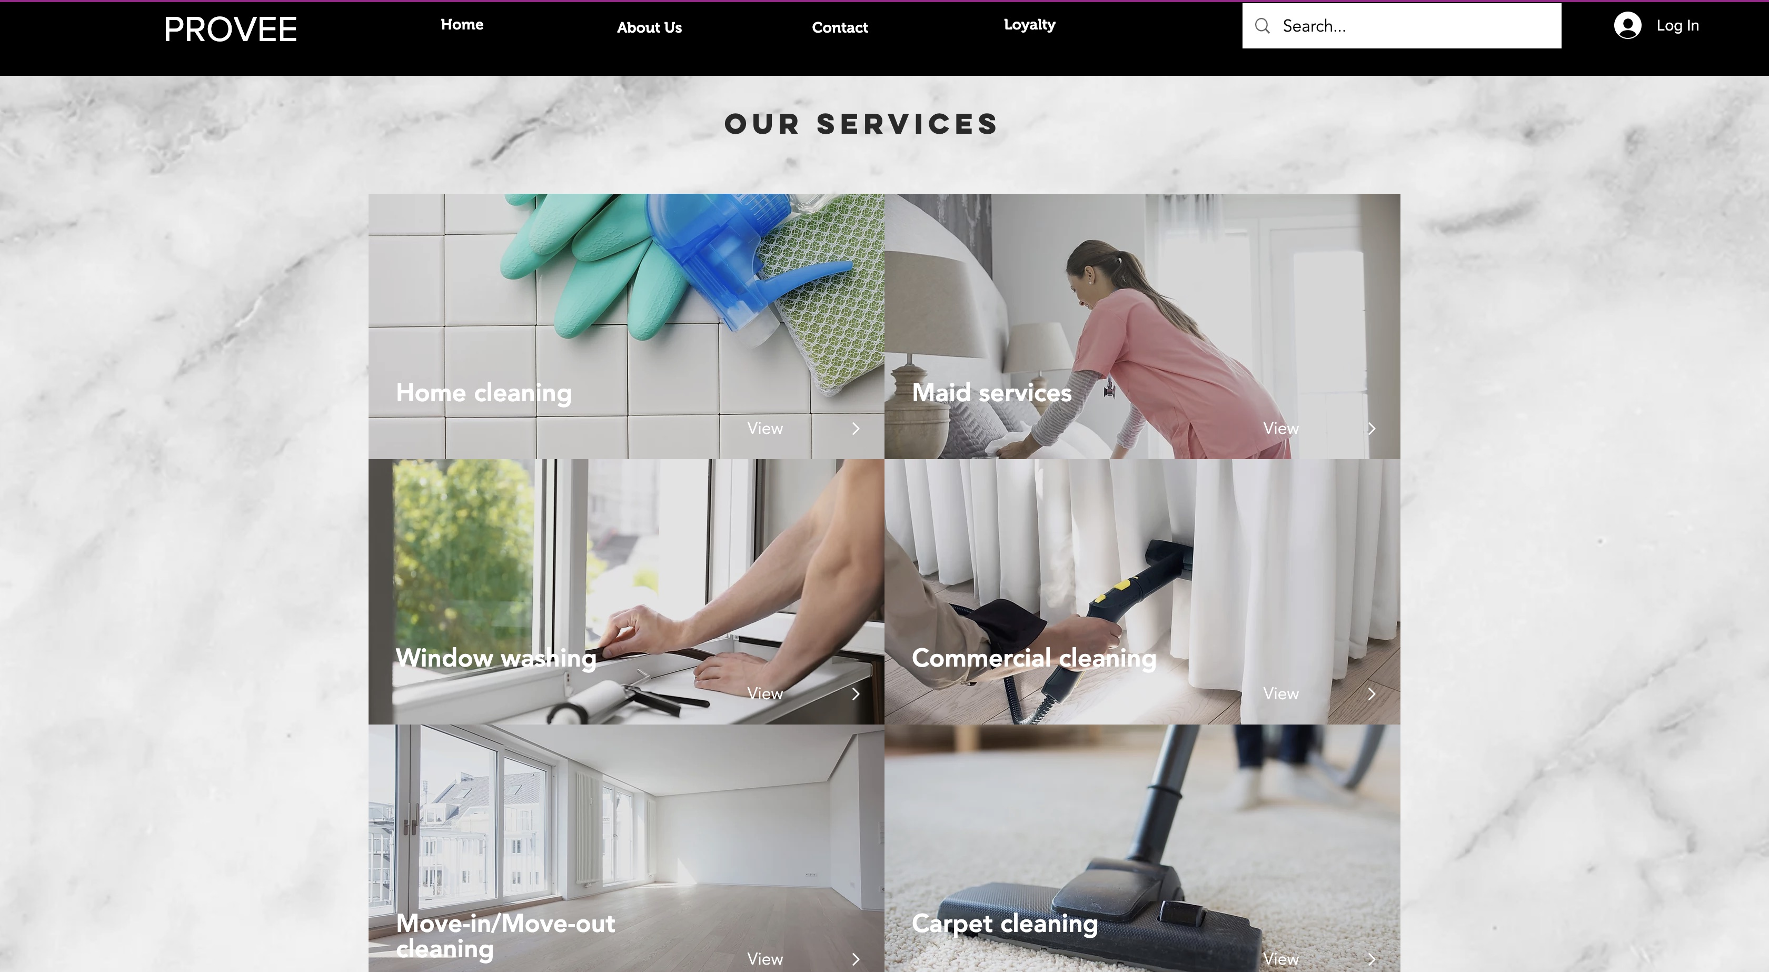
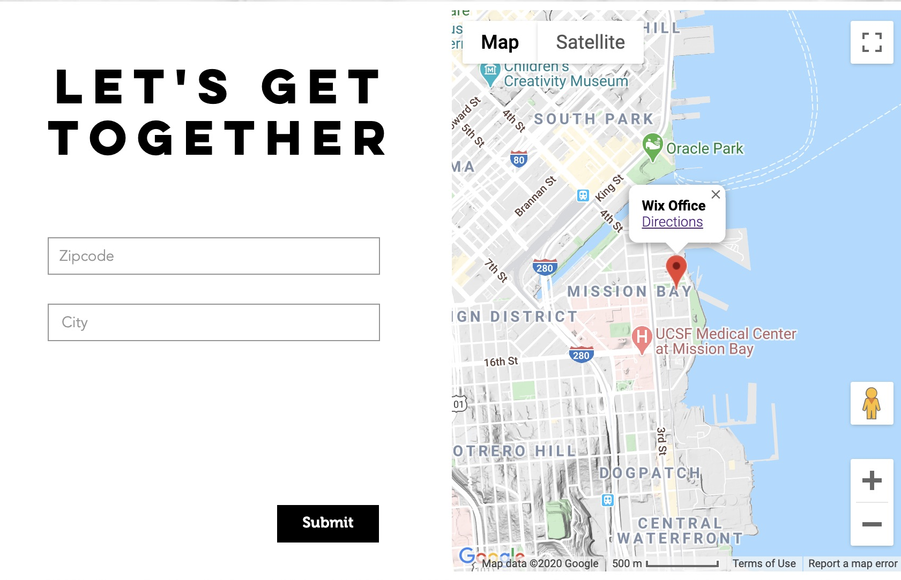
Customer Booking: Choose Service & Location
Customer login
Customer will select service offering
Service Categories
Customer will select location

Slide 8
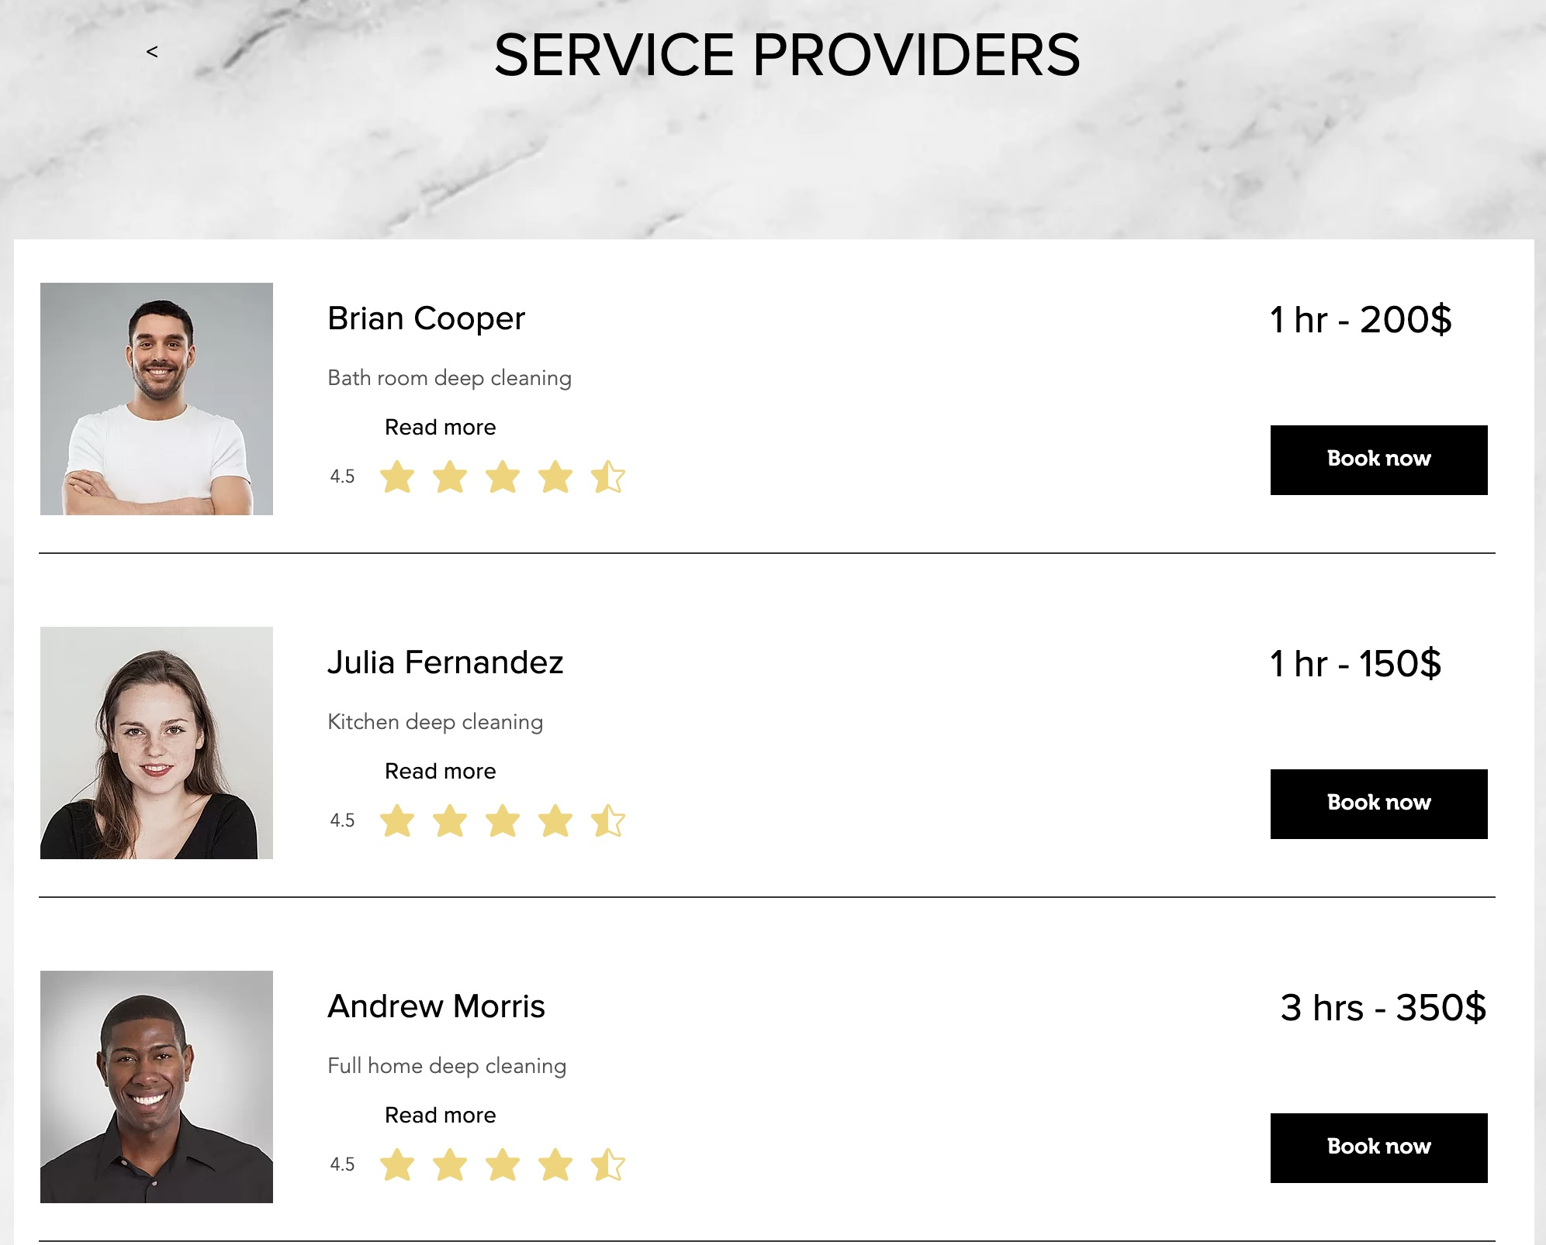
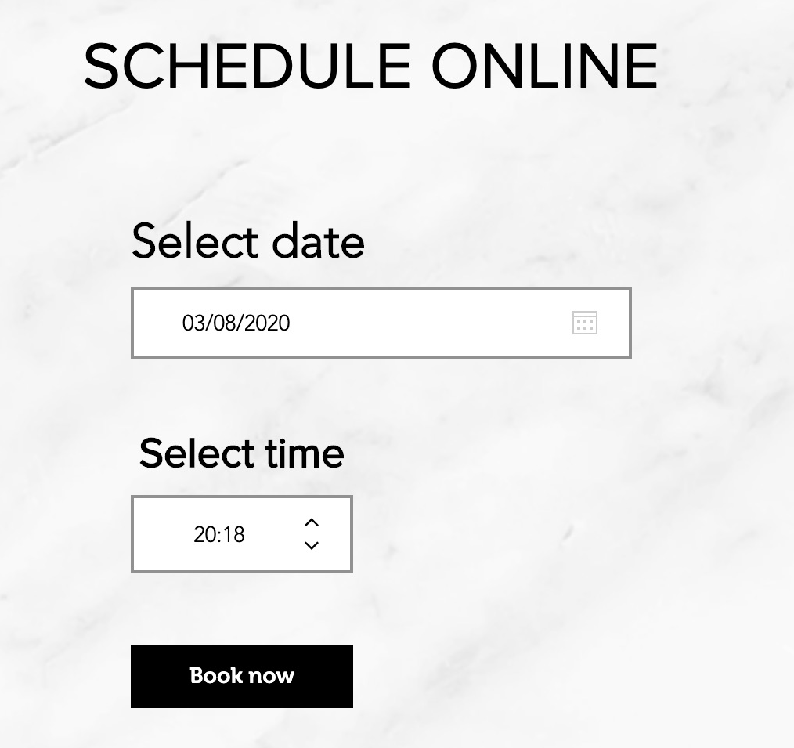
Customer Booking: Choose provider & schedule
Customer will select service provider
Book service provider
Select date and time

Slide 9
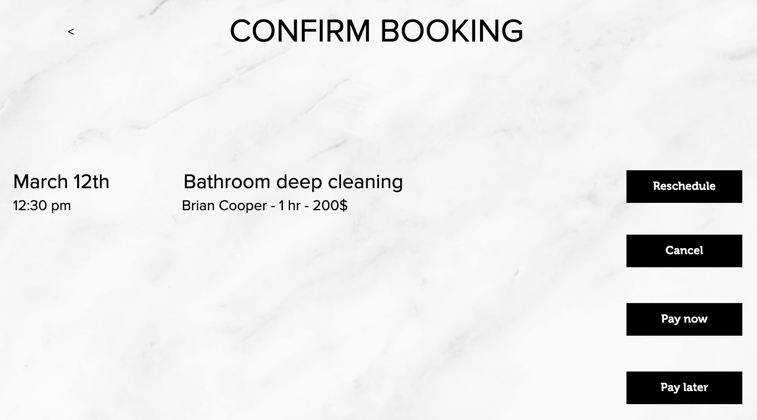
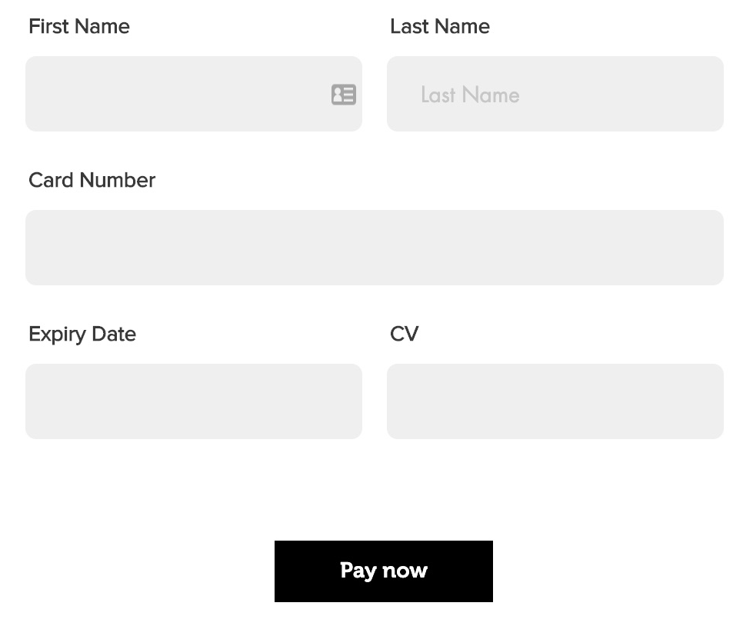

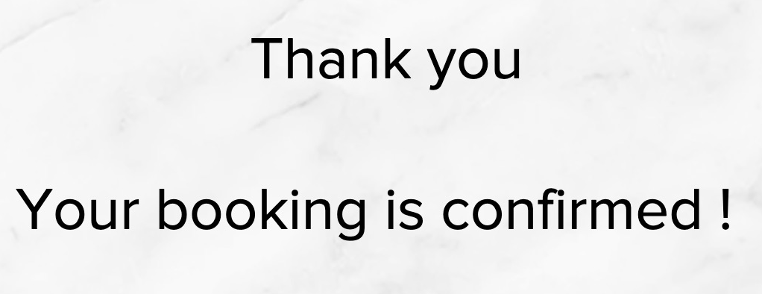
Customer Booking: Make payment & Book
Booking Confirmation
Options
Make Payment

Slide 10
Future Scope
Scale up to include more services to improve customer experience
Expand to more cities and slowly start catering to more counties
Skill & behavioral training to service professionals

Slide 11
Thank You
Moushumi Bhattacharya
Mansi Rathi
Monica Jain
Joshua Wang

